Slide 1
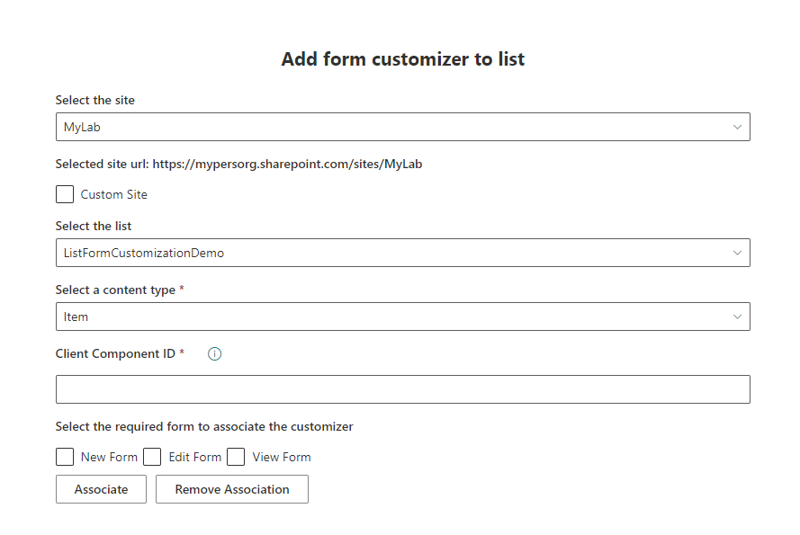

Building Utility solution to manage SPFx form
customizer in list
react-add-formcustomizer-to-list
Siddharth Vaghasia (@siddh_me)

Slide 3












Siddharth Vaghasia
Microsoft 365 | Independent Consultant
SharePoint, Teams App, Power Platform, Azure, .NET
https://siddharthvaghasia.com
https://c-sharpcorner.com/members/siddharth-vaghasia
@siddh_me
siddharth-vaghasia
https://www.linkedin.com/in/siddharthvaghasia

Slide 4

react-add-formcustomizer-to-list
Webpart to allow user to associate form customizer to list/library
https://github.com/pnp/sp-dev-fx-webparts/tree/main/samples/react-add-formcustomizer-to-list

Slide 5
Driving Factor
Form Customizer to List/Libraries with SPFx 1.15
Needs to do association to Content Type via component ID
PowerShell, REST API and CSOM
Ability to do via User Interface
Associate with multiple list libraries

Slide 6
Summary
Utility webpart to Simple interface to associate/remove
Can be used to do it as across site collections
Ability to Select Site, List, Content Type
Ability to Associate/Remove
Ability to choose form type(view/edit/new)

Slide 7
Notes
/sites/MyLab/_api/Web/Lists(“idoflist”)/ContentTypes(“contenttypeid”)
Patch Method
Object to Pass
{
'__metadata': {
'type': 'SP.ContentType'
},
'NewFormClientSideComponentId: '',
'DispFormClientSideComponentId': '',
'EditFormClientSideComponentId': '',
‘NewFormClientSideComponentProperties': {},
‘DispFormClientSideComponentProperties': {}
‘EditFormClientSideComponentProperties': {}
}

Slide 8
Demo/ Code Walkthrough

Slide 9
THANK YOU

